Slide 1


Kilin Widjaja
25 March 2024

Slide 2
Outline
Executive Summary
Introduction
Methodology
Results
Conclusion
Appendix

Slide 3
Executive Summary
Summary of methodologies
Data Collection using Space X API and Web scraping
Data Wrangling
Exploratory Data Analysis using SQL and Visualization
Interactive Visual Analytics with Folium and Plotly Dash
Machine Learning Predictive Analysis
Summary of all results
Exploratory Data Analytics shows which variables are best to predict success of landings
Interactive Visual Analytics and Dashboards help visualize the findings
Classification Predictive Analysis shows the result of the model used to predict success of landings

Slide 4
Introduction
Project background and context
SpaceX advertises Falcon 9 rocket launches on its website with a cost of 62 million dollars, compare to other providers cost upward of 165 million dollars each. This much of savings is because SpaceX can reuse the first stage. This project is to help new company SpaceY to determine their cost of launches in order to compete with SpaceX.
Problems you want to find answers
Therefore if we can determine if the first stage will land, we can determine the cost of a launch. In this project, we are predicting if the first stage will be able to land and reuse it.

Slide 5

Section 1

Slide 6
Methodology
Executive Summary
Data collection methodology
Perform data wrangling
Converting the outcome into training labels with successful and unsuccessful outcome
Perform exploratory data analysis (EDA) using Data Visualization and SQL
Perform interactive visual analytics using Folium and Plotly Dash
Perform predictive analysis using classification models
Building, tuning, evaluating classification models

Slide 7
Data Collection
Data sets were collected by using:
SpaceX API (https://api.spacexdata.com/v4/rockets/)
Web scraping from https://en.wikipedia.org/wiki/List_of_Falcon_9_and_Falcon_Heavy_launches

Slide 8
Data Collection – SpaceX API
Request SpaceX API data
Decode using json.normalize()
Construct data and create new dataframe
Replace missing values with mean values
Filtering the dataframe to only include Falcon 9 launches
Request API and decode SpaceX data
GitHub URL of the completed SpaceX API calls notebook, https://github.com/kilinwid/IBM-Applied-Data-Science-Capstone/blob/151f5277bf1243bd22ae8a3b627540477ac2f853/jupyter-labs-spacex-data-collection-api.ipynb

Slide 9
Data Collection - Scraping
Request Falcon 9 launch data from Wikipedia
Create a BeautifulSoup object from HTML response
Extracting column/variable names from HTML header
Create dataframe from dictionary
Construct data into dictionary
Create dataframe by parsing launch HTML tables
GitHub URL of the completed web scraping notebook, https://github.com/kilinwid/IBM-Applied-Data-Science-Capstone/blob/151f5277bf1243bd22ae8a3b627540477ac2f853/jupyter-labs-webscraping.ipynb

Slide 10
Data Wrangling
Perform initial EDA on the data
Data Analysis Calculations
Create landing Outcome label
Performing Data Analysis by:
Calculate the number of launches on each site
Calculate the number and occurrence of each orbit
Calculate the number and occurrence of mission outcome of the orbits
Create a landing outcome label from Outcome column
GitHub URL of the completed data wrangling notebook, https://github.com/kilinwid/IBM-Applied-Data-Science-Capstone/blob/151f5277bf1243bd22ae8a3b627540477ac2f853/labs-jupyter-spacex-Data%20wrangling.ipynb

Slide 11
EDA with Data Visualization
Plotted chart:
Flight Number vs. Pay Load Mass Chart
Flight Number vs. Launch Site Chart
Pay Load Mass vs. Launch Site Chart
Success Rate of each Orbit Type Chart
Flight Number vs. Orbit Type Chart
Pay Load Mass vs. Orbit Type Chart
Launch Success Yearly Trend
These charts are plotted to see the relationship between two variables
GitHub URL of the completed EDA with data visualization notebook, https://github.com/kilinwid/IBM-Applied-Data-Science-Capstone/blob/151f5277bf1243bd22ae8a3b627540477ac2f853/jupyter-labs-eda-dataviz.ipynb.jupyterlite.ipynb

Slide 12
EDA with SQL
The SQL queries performed:
Display the names of unique launch sites in the space mission
Display top 5 launch sites that name begin with string ‘CCA’
Display total Payload Mass carried by boosters launched by NASA (CRS)
Display the average Payload Mass carried by booster version F9 v1.1
List the date when the first successful landing outcome in ground pad was achieved
List the names of the boosters which have success in drone ship and payload mass between 4000 and 6000 kg
List the total number of successful and failure mission outcomes
List the names of the booster version which have carried the maximum payload mass
List the failed landing outcomes in drone ship, booster version, and launch site for the months in year 2015
Rank the landing count outcomes between 2010-06-04 and 2017-03-20 in descending order
GitHub URL of the completed EDA with SQL notebook, https://github.com/kilinwid/IBM-Applied-Data-Science-Capstone/blob/151f5277bf1243bd22ae8a3b627540477ac2f853/jupyter-labs-eda-sql-coursera_sqllite.ipynb

Slide 13
Build an Interactive Map with Folium
Create Folium Map with:
Marking all launch sites on the map
Marking all successful or failed launches for each launch site on the map
Calculate the distance between from launch site to its proximities
Create line marker between launch site to its proximities
The markers are used to help us visualize better about each launch sites on the map
GitHub URL of the completed interactive map with Folium map, https://github.com/kilinwid/IBM-Applied-Data-Science-Capstone/blob/151f5277bf1243bd22ae8a3b627540477ac2f853/lab_jupyter_launch_site_location.jupyterlite.ipynb

Slide 14
Build a Dashboard with Plotly Dash
Interactive Dashboard made by Plotly:
There are two part, first part is pie chart and the second part is scatter plot
Both chart and plot are Payload Mass vs Success Rate
Pie chart can be changed interactively by selecting Launch Site
Scatter plot can be change interactively by selecting Payload Mass
This interactive dashboard can quickly visualize which launch site has better success rate considering its launch’s payload mass
GitHub URL of your completed Plotly Dash lab, https://github.com/kilinwid/IBM-Applied-Data-Science-Capstone/blob/151f5277bf1243bd22ae8a3b627540477ac2f853/spacex_dash_app.py

Slide 15
Predictive Analysis (Classification)
Creating Array and Standardized Data
Using GridSearchCV for each model
Comparing the results from 4 models
For Machine Learning Predictive Analysis, we use four models: Logistic Regression, Support Vector Machine, Decision Tree, and K nearest neighbors
GitHub URL of the completed predictive analysis lab, https://github.com/kilinwid/IBM-Applied-Data-Science-Capstone/blob/151f5277bf1243bd22ae8a3b627540477ac2f853/SpaceX_Machine_Learning_Prediction_Part_5.jupyterlite.ipynb

Slide 16
Exploratory Data Analysis Results
There are four launch sites used by SpaceX
The first successful landing on ground pad is on December 22, 2015
There are four type of booster used for Payload Mass between 4000 and 6000 kg
Only one failed mission outcome from 101 launches
There are twelve type booster successfully launched maximum Payload Mass (15,600 kg)
There are two type booster failed landing outcome in 2015
The most successful landing outcome is using drone ship (5 times)
Landing outcome success rate is continuously getting higher, starting from 2014

Slide 17
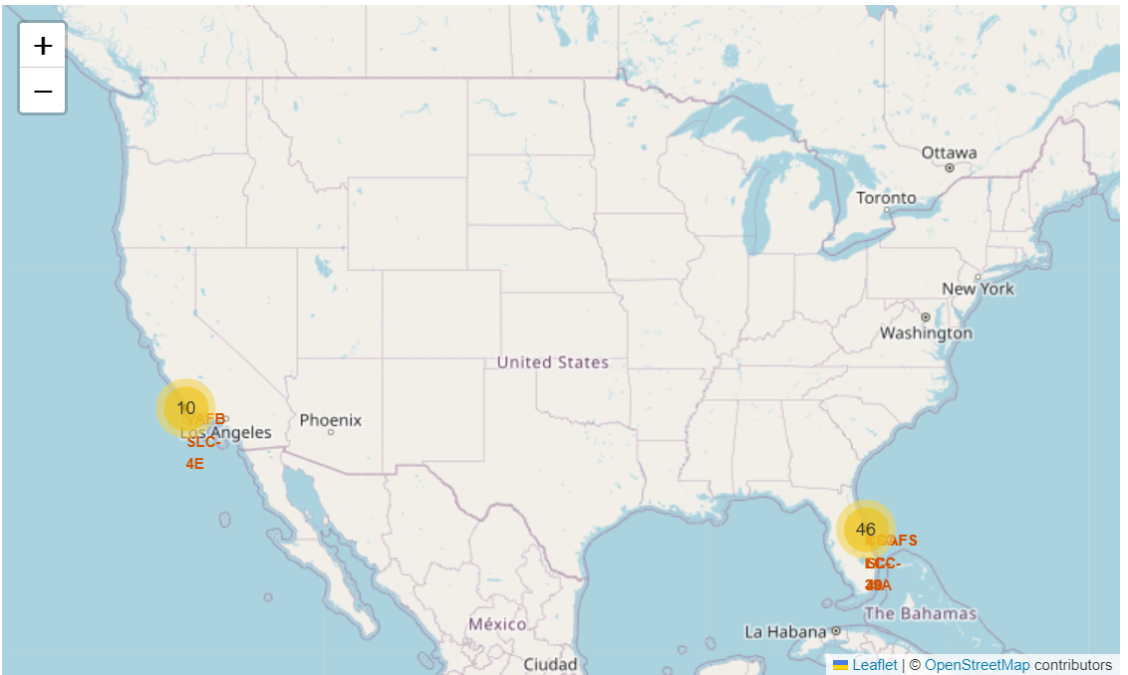
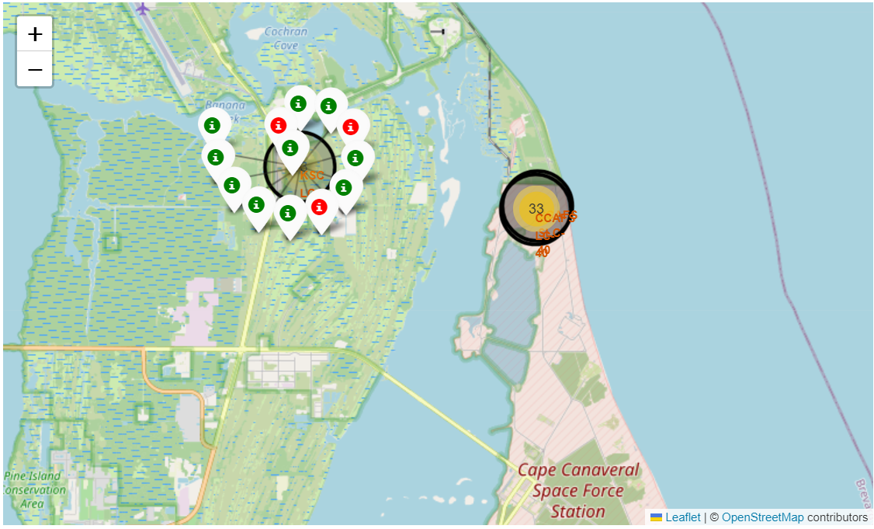
Interactive Analytics Demo Results
There are 10 launches on west coast and 46 launches on east coast
KSC LC-39A has 77% success rate, which is the highest among all four sites

Slide 18
Predictive Analysis Results
Logistic Regression has an accuracy of 84.6% and test score of 83.3%
Support Vector Machine has an accuracy 84.8% of and test score of 83.3%
Decision Tree has an accuracy of 86.3% and test score of 83.3%
K-nearest neighbors has an accuracy of 84.8% and test score of 83.3%
We have the same test score for all four methods

Slide 19

Section 2

Slide 20
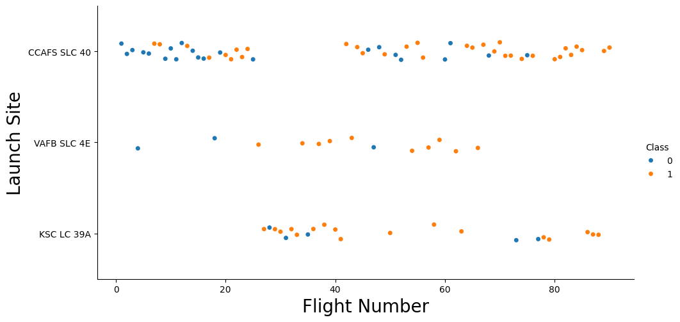
Flight Number vs. Launch Site
According to the graph, general success rate has improved over time
CCAFS SLC-40 has more launches than the other two sites
In recent launches (after flight number 60), VAFB SLC-4E has the highest success (minimal launches), CCAFS SLC-40 come second (most launches)

Slide 21
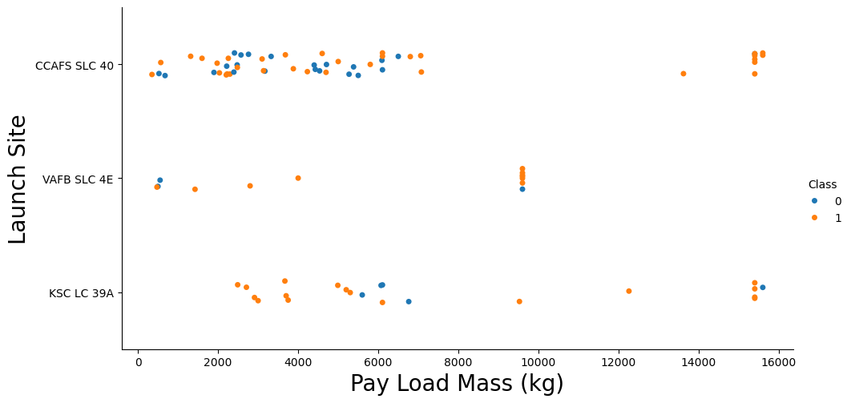
Payload vs. Launch Site
Payload Mass over 8,000 kg has higher success rate
Payload Mass over 12,000 kg can only launched from CCAFS SLC-40 and KSC LC-39A

Slide 22
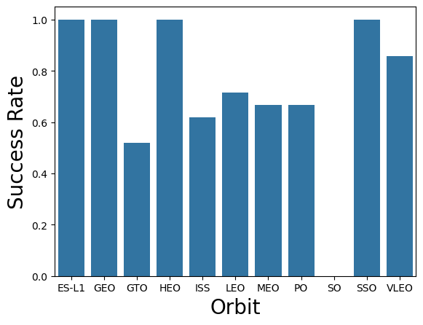
Success Rate vs. Orbit Type
Four Orbits has 100% success rate: ES-L1, GEO, HEO, and SSO
SO has 0% success rate
The other orbits have success rate in between

Slide 23
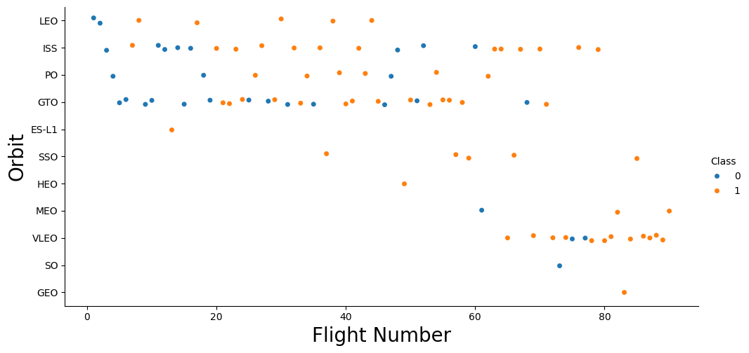
Flight Number vs. Orbit Type
From the graph shown that success rate improve over time
LEO has better success after first two fail rate
GTO has some mix results

Slide 24
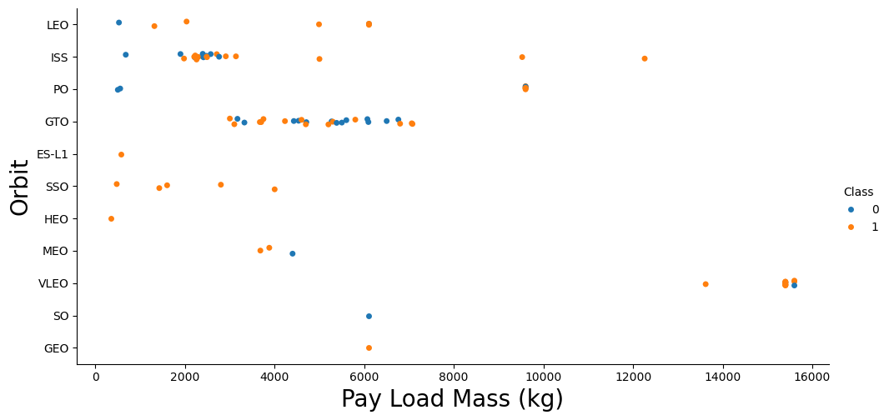
Payload vs. Orbit Type
GTO and VLEO have mixed results
LEO and ISS have better success rate over higher Payload Mass

Slide 25
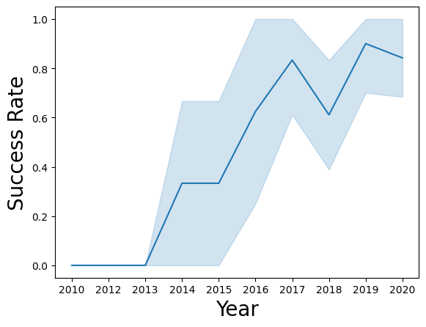
Launch Success Yearly Trend
From the graph shows that SpaceX has 3 year learning curve to adjust
Success rate has improvement trend from 2014 to 2020

Slide 26
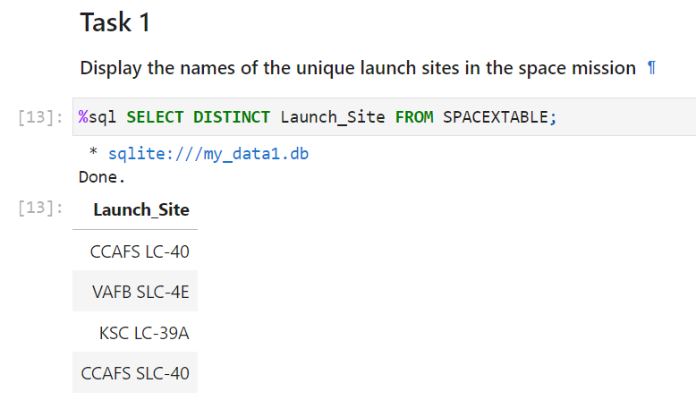
All Launch Site Names
Using the query, there are four unique launch sites according to the data

Slide 27
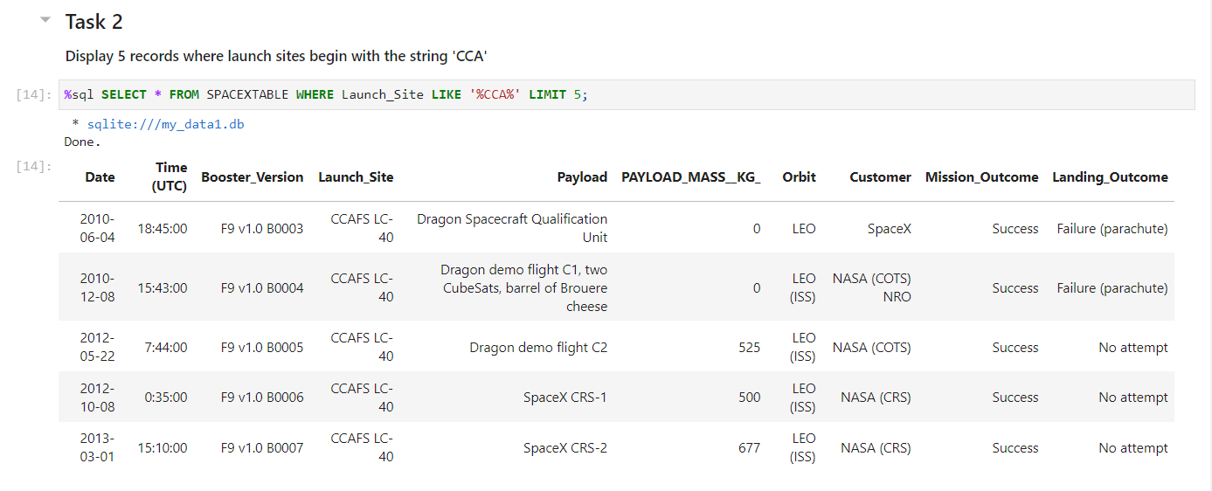
Launch Site Names Begin with 'CCA'
Using the query for five sample launch data that begin with string ‘CCA’

Slide 28
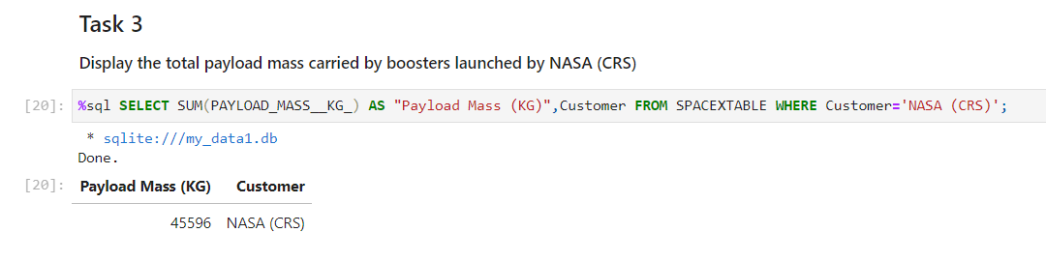
Total Payload Mass
Using the query to calculate the total payload carried by boosters from NASA

Slide 29
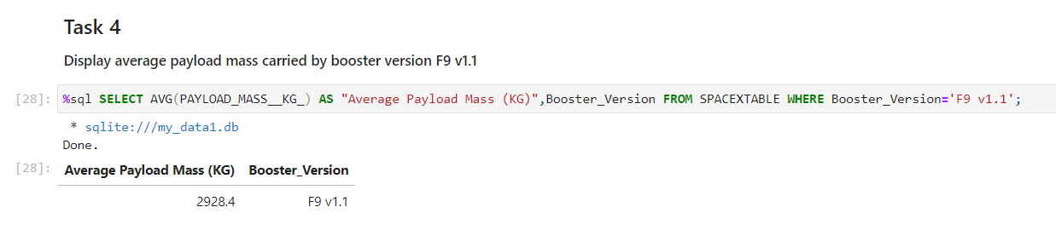
Average Payload Mass by F9 v1.1
Using the query to calculate the average payload mass carried by booster version F9 v1.1

Slide 30
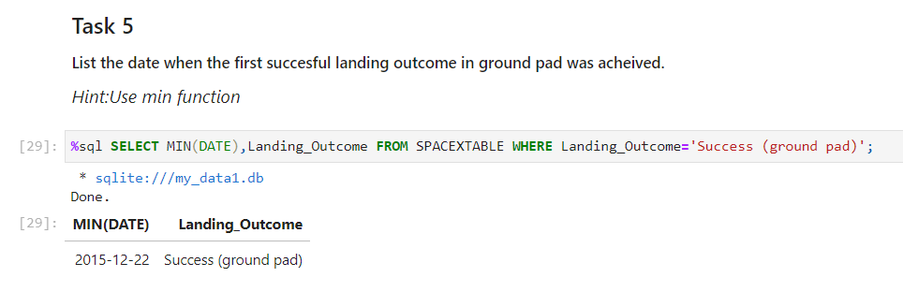
First Successful Ground Landing Date
Using the query to find the dates of the first successful landing outcome on ground pad

Slide 31
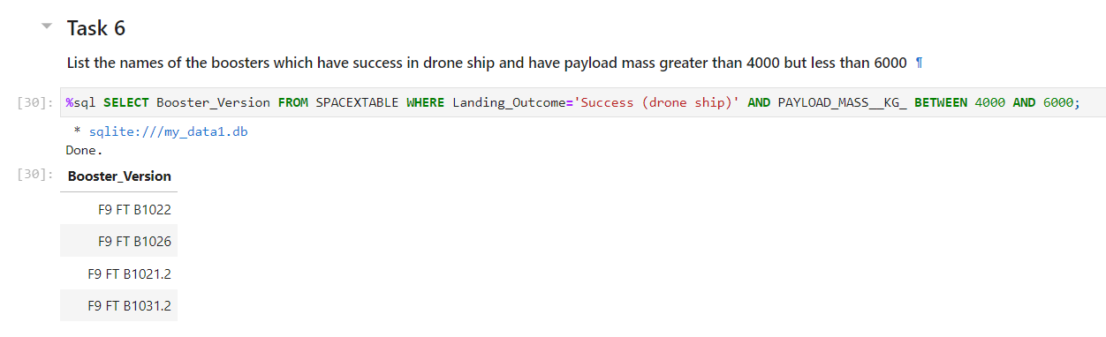
Successful Drone Ship Landing with Payload between 4000 and 6000
Using the query to list the names of boosters which have successfully landed on drone ship and had payload mass greater than 4000 but less than 6000

Slide 32
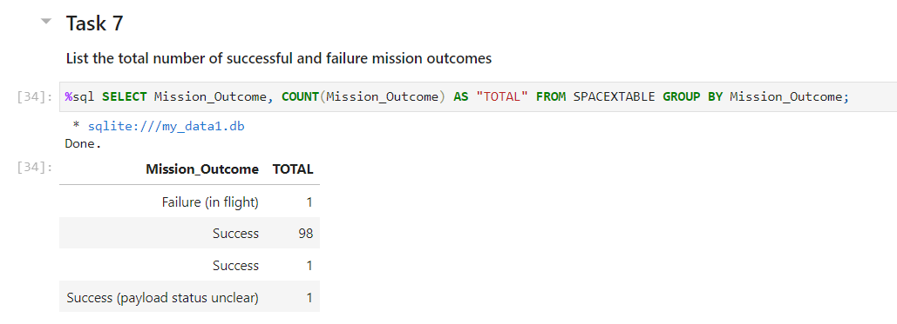
Total Number of Successful and Failure Mission Outcomes
Using the query to calculate the total number of successful and failure mission outcomes

Slide 33
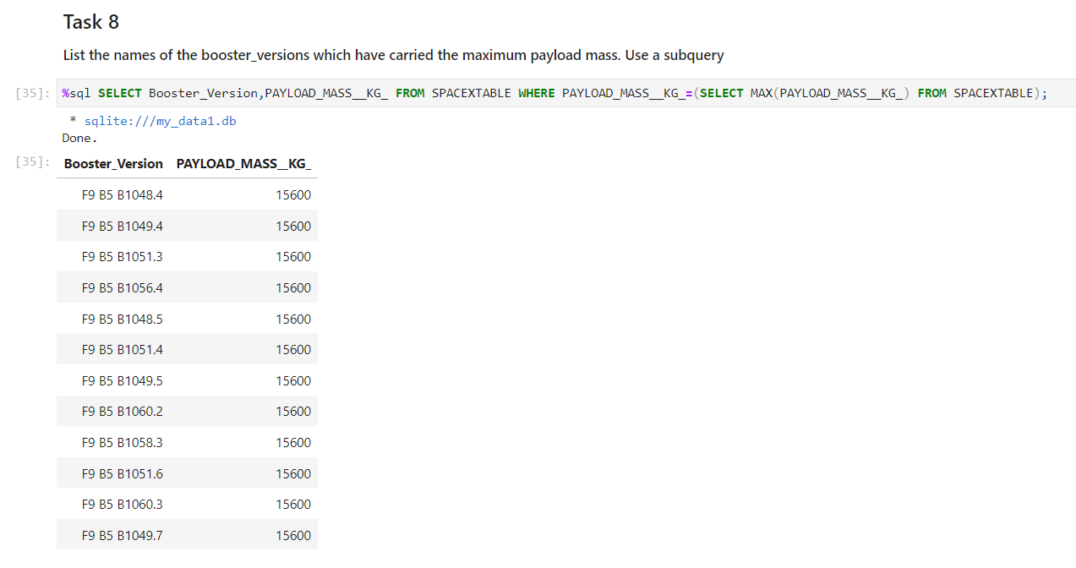
Boosters Carried Maximum Payload
Using the query to list the names of the booster which have carried the maximum payload mass

Slide 34
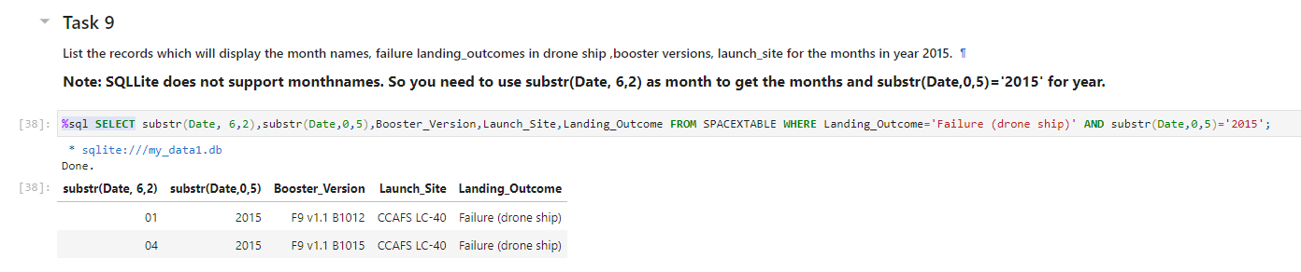
2015 Launch Records
Using the query to list the failed landing outcomes in drone ship, their booster versions, and launch site names for in year 2015

Slide 35
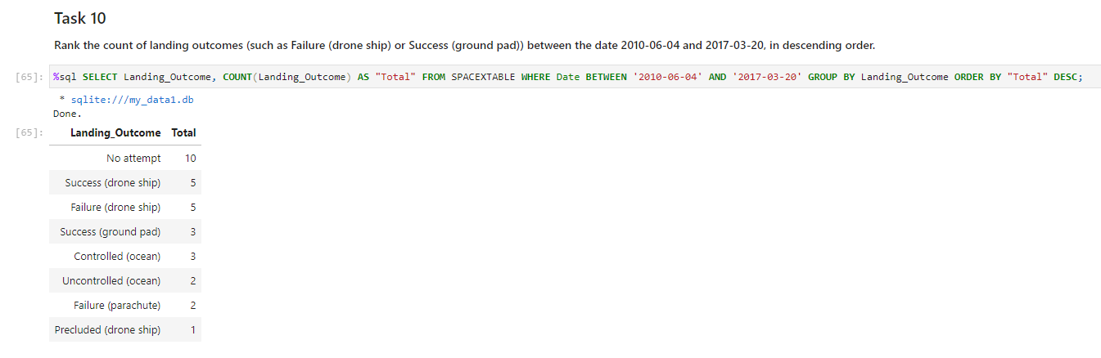
Rank Landing Outcomes Between 2010-06-04 and 2017-03-20
Using the query to rank the count of landing outcomes (such as Failure (drone ship) or Success (ground pad)) between the date 2010-06-04 and 2017-03-20, in descending order

Slide 36

Section 3

Slide 37
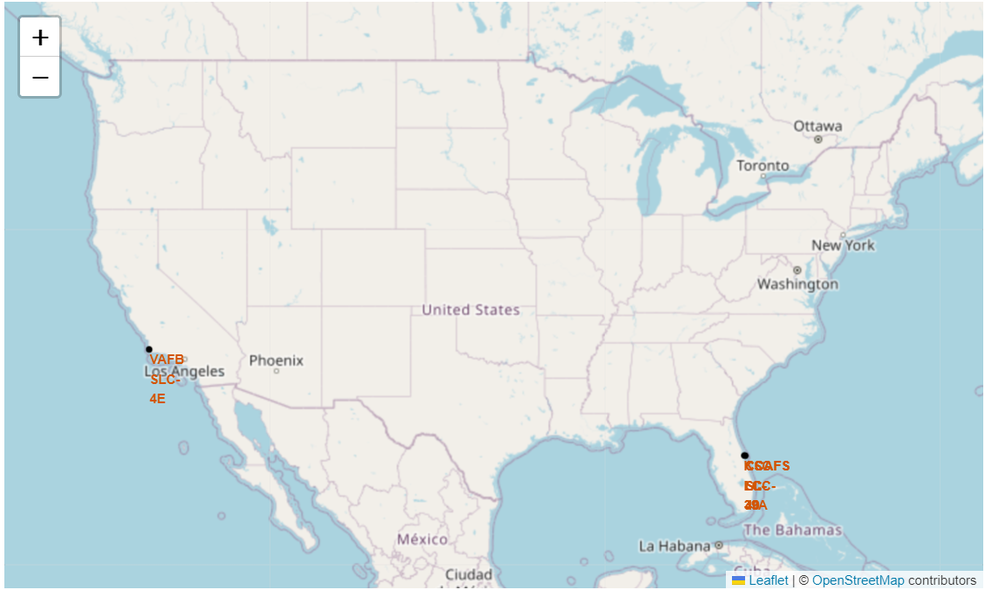
Launch Sites
There is one launch site in West coast and three launch sites in East coast
All four launch site is near coast line

Slide 38
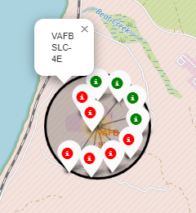
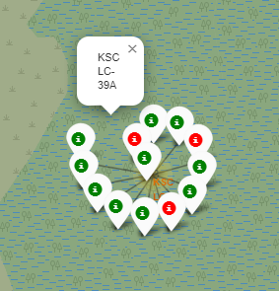
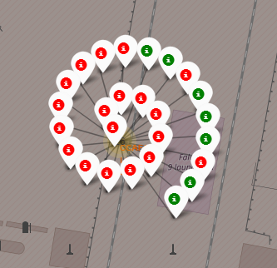
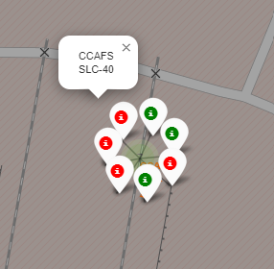
Site Launch Outcomes
Below is the four launch sites outcomes, from left, VAFB SLC-4E, KSC LC-39A, CCAFS LC-40, CCAFS SLC-40
Best outcome is from launch site KSC LC-39A

Slide 39
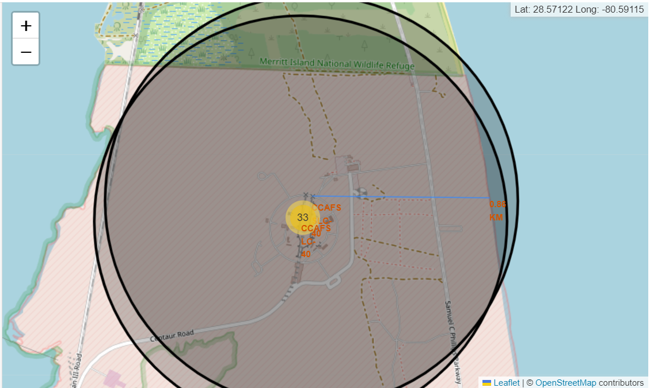
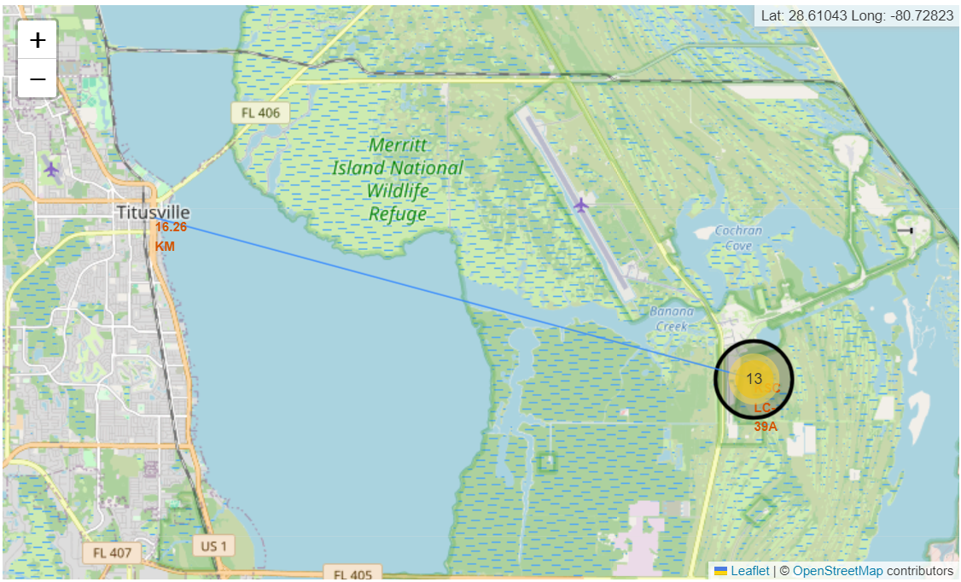
Distance from Launch Site to its proximities
Distance to coast line is 0.86 km
Distance to Titusville (closest city) is 16.26 km

Slide 40

Section 4

Slide 41
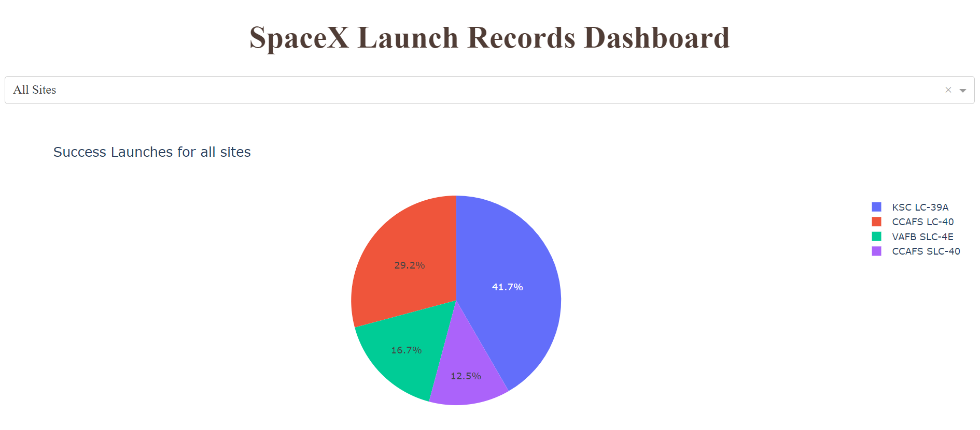
Success Launch Outcome for all sites
KSC LC-39A has most success launch outcomes compare to other three sites

Slide 42
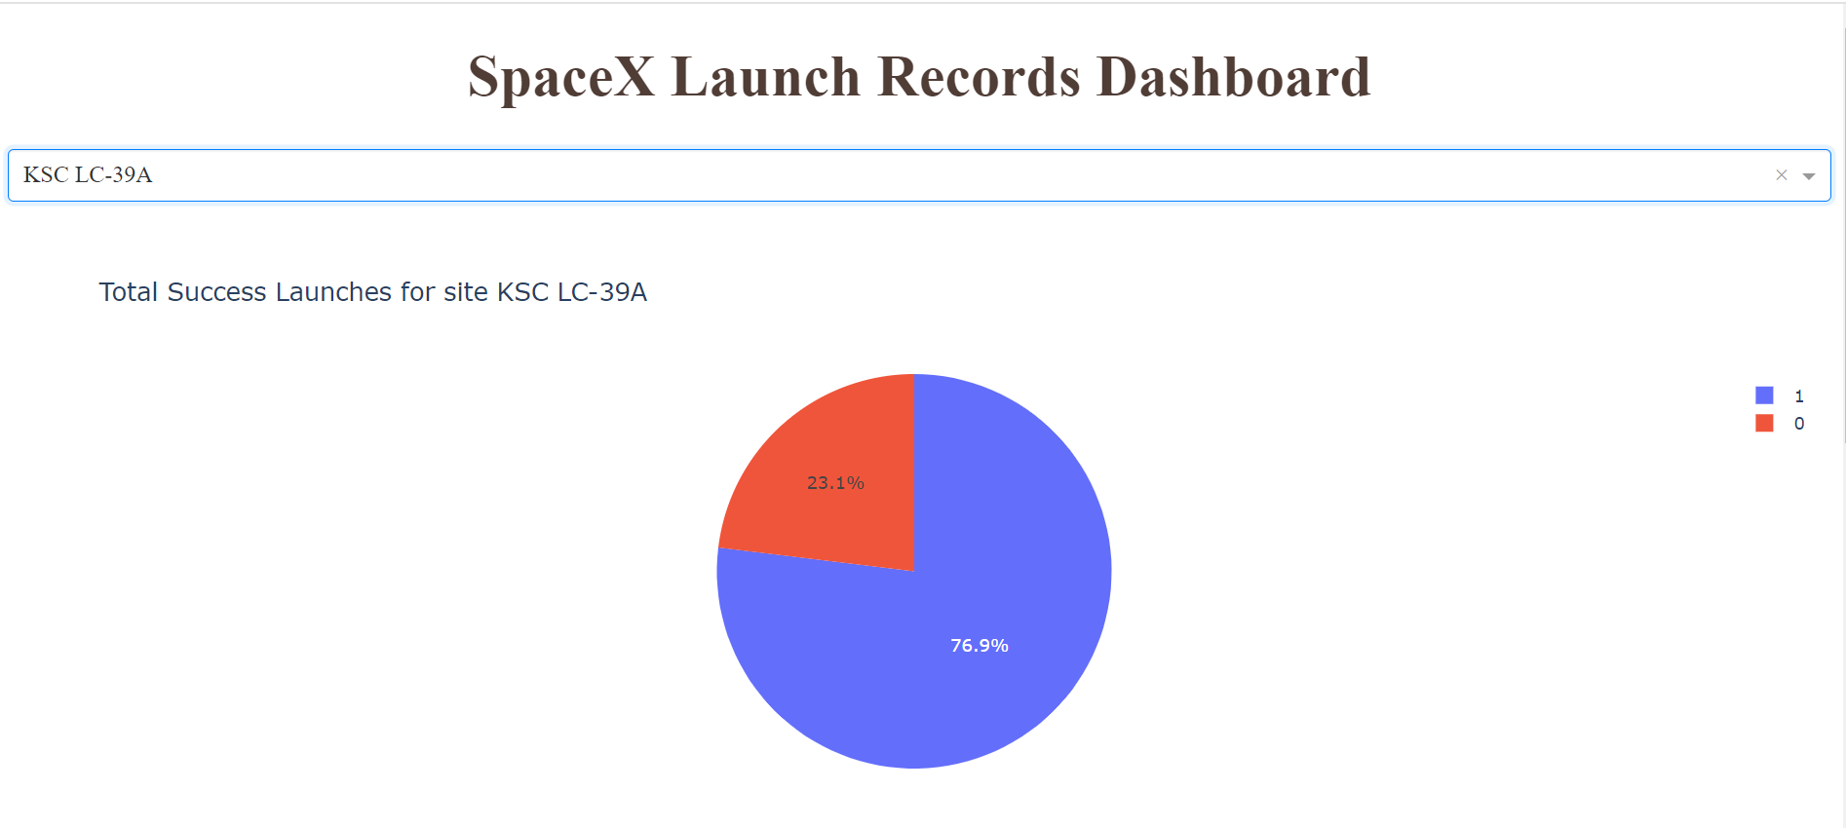
The highest Launch Outcome success ratio site
KSC LC-39A also has the highest success launch ration compare to other three sites

Slide 43
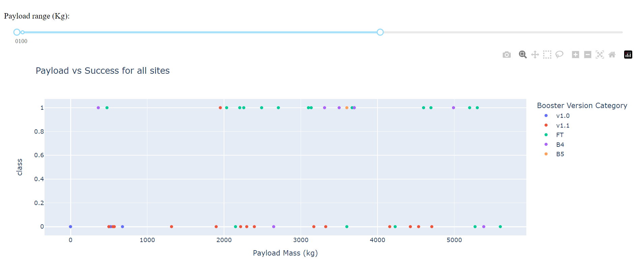
Payload mass vs. Launch Outcome for all sites (1)
Under 6,000 kg, FT booster has best success outcome

Slide 44
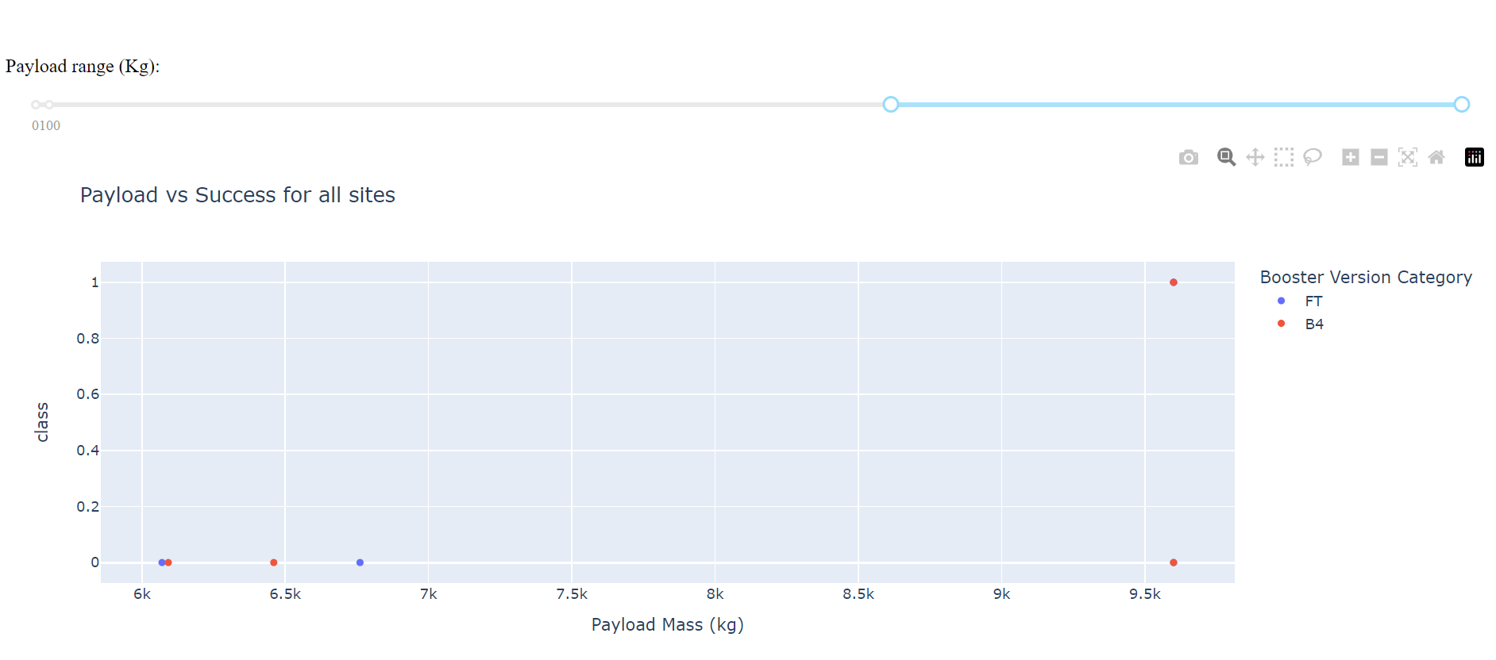
Payload mass vs. Launch Outcome for all sites (2)
Between 6,000 kg and 10,000 kg, only one launch is successful

Slide 45

Section 5

Slide 46
Classification Accuracy
From the table, we can see that all four methods has the same test accuracy
So we can not pick the best, since all methods have the same test accuracy
 | Accuracy | Test Accuracy
Log Regression | 0.846 | 0.833
SVM | 0.848 | 0.833
Decision Tree | 0.863 | 0.833
KNN | 0.848 | 0.833

Slide 47
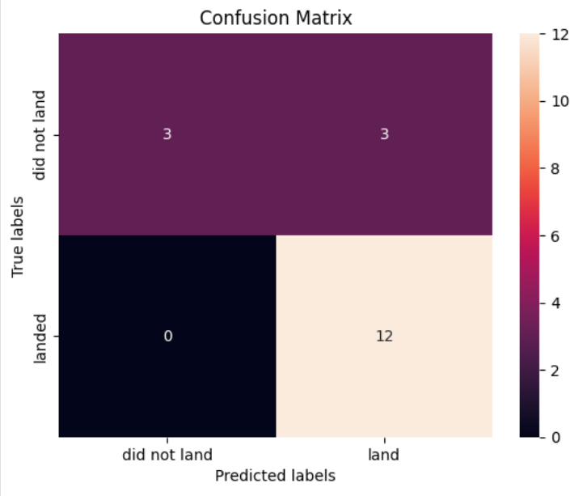
Confusion Matrix
Since all four methods have the same test score accuracy, they have the same confusion matrix
All the methods have the same problem with false positive

Slide 48
Conclusions
Landing outcome success rate has improvement trend from 2014 to 2020
Launch site KSC LC-39A has the best success rate compare to other three sites
ES-L1, GEO, HEO, and SSO orbit launch has 100% success rate
Machine Learning Predictive model has the same test accuracy, any of the four models can be used
The distance from launch site to its proximities need to have a certain distance

Slide 49


